Slide 1
10 minutes of reading!
-Have your note cards ready (only a few people at a time at the shelf)

Slide 2
OYD (On your desk) only
Pencil
Handout
Crossover book
Vocabulary notecards

Slide 3
Affixes
Prefixes and suffixes; must be attached to a root or base word

Slide 6
Affixes in The Crossover
Page 170 and 173
eating grinning invisible
Surprisingly scrubbed appointment

Slide 7
Alliteration
Def: The repetition (repeating) of the beginning sound of words
Ex:
Peter Piper picked a peck of pickled peppers.
Slithering snakes sound scary.
The rumbling roar of the truck filled the field.

Slide 8
Alliteration in The Crossover
Page 3
Crunking, crisscrossing
Page 10
mythical manchild, dubious distinction
Page 13
Banished to the backseat

Slide 9
Guess the Allusion
Reference to a person, place, event, or thing is history, myth, or another work of literature.

Slide 10
Guess who or what these allusions are alluding (referring) to!
"I was trying to fly without leaving the ground, Cause I wanted to be like Mike, right, Wanted to be him, I wanted to be that guy, I wanted to touch the rim"
“You were Romeo, your were throwing pebbles…my daddy said stay away from Juliet.”

Slide 11
3. The Percy Jackson series makes allusions (references) to what?
4. When will I meet my Prince Charming?
5. Her life is a Cinderella story.

Slide 12
6. He is so perfect, he walks on water.
7. Don’t fly too close to the sun.
8. You must be lying because your nose is growing.

Slide 13
9. Oh, don’t be such a Scrooge.
10. You shot me out of the sky, you’re my kryptonite, you make me weak.

Slide 14
Allusions in The Crossover
Page 4
“balled with Magic and the Goat”
Page 79
“Greenish ham….mom wanted to ask if he had any eggs to go with it.”
Dr. Suess Green Eggs and Ham

Slide 15
Analogy
An expression that shows similarity between two unlike things or situations

Slide 16
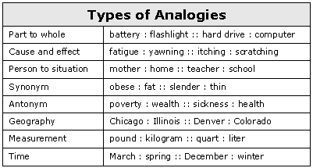

Slide 17
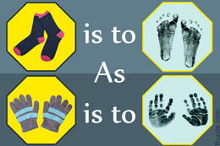
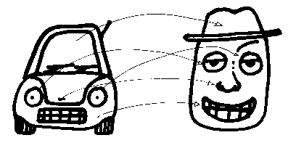

Slide 18
Analogies in The Crossover
Page 30
His feet are the bank ,and I’m the crook
Two in my kitchen, I’m fixing to cook
Page 91
Talking to JB right now would be like pushing water uphill with a rake

Slide 19
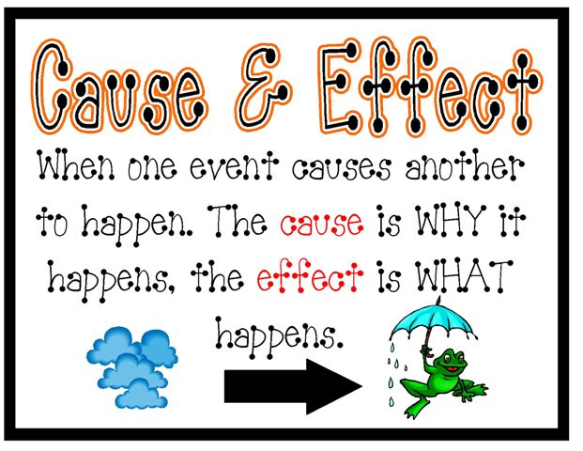
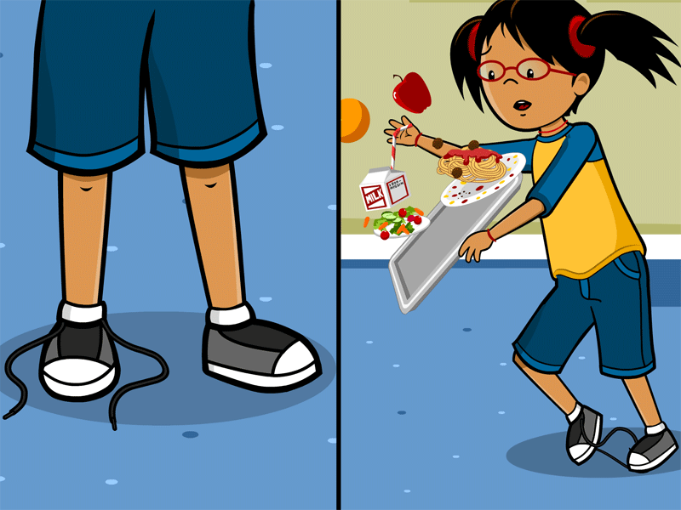
Cause and Effect
Affect=Action, verb
Effect=Noun, thing

Slide 20
Cause and Effect in The Crossover
Cause:Chuck “Da’ Man” Bell refuses to eat healthy and go to the doctor.
Effect: High blood pressure
Cause: High blood pressure not taken care of with healthy food or medication.
Effect: Dad has a myocardial infarction (heart attack)

Slide 21
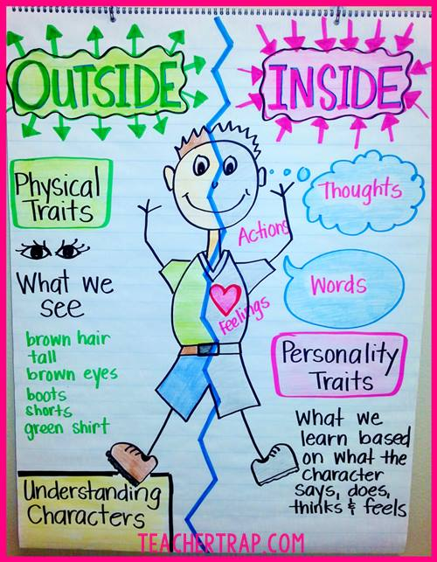
Character Traits
Physical and/or personality descriptions of a character

Slide 22
Character Traits in The Crossover
Josh’s character traits:
Page 4, 10, 23
JB’s character traits:
Page 11, 23

Slide 23
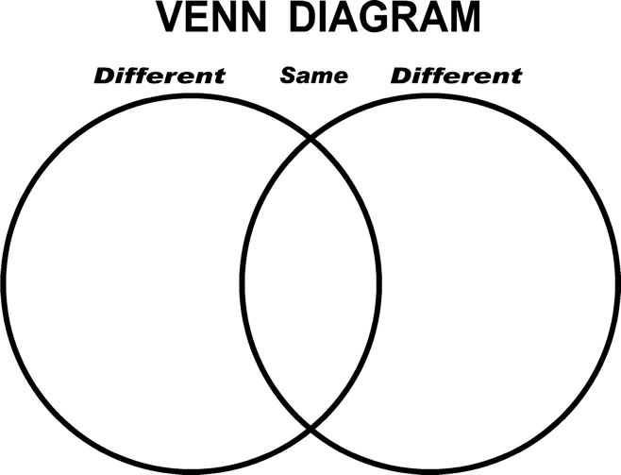
Compare and Contrast
To tell how things are alike or different

Slide 24
Compare and Contrast in The Crossover
Use page 23 to fill in a chart or diagram comparing and contrasting JB and Josh

Slide 25
Conflict
Struggle or class between opposing characters or opposing forces.
https://www.youtube.com/watch?v=rg_10OfdEss

Slide 26
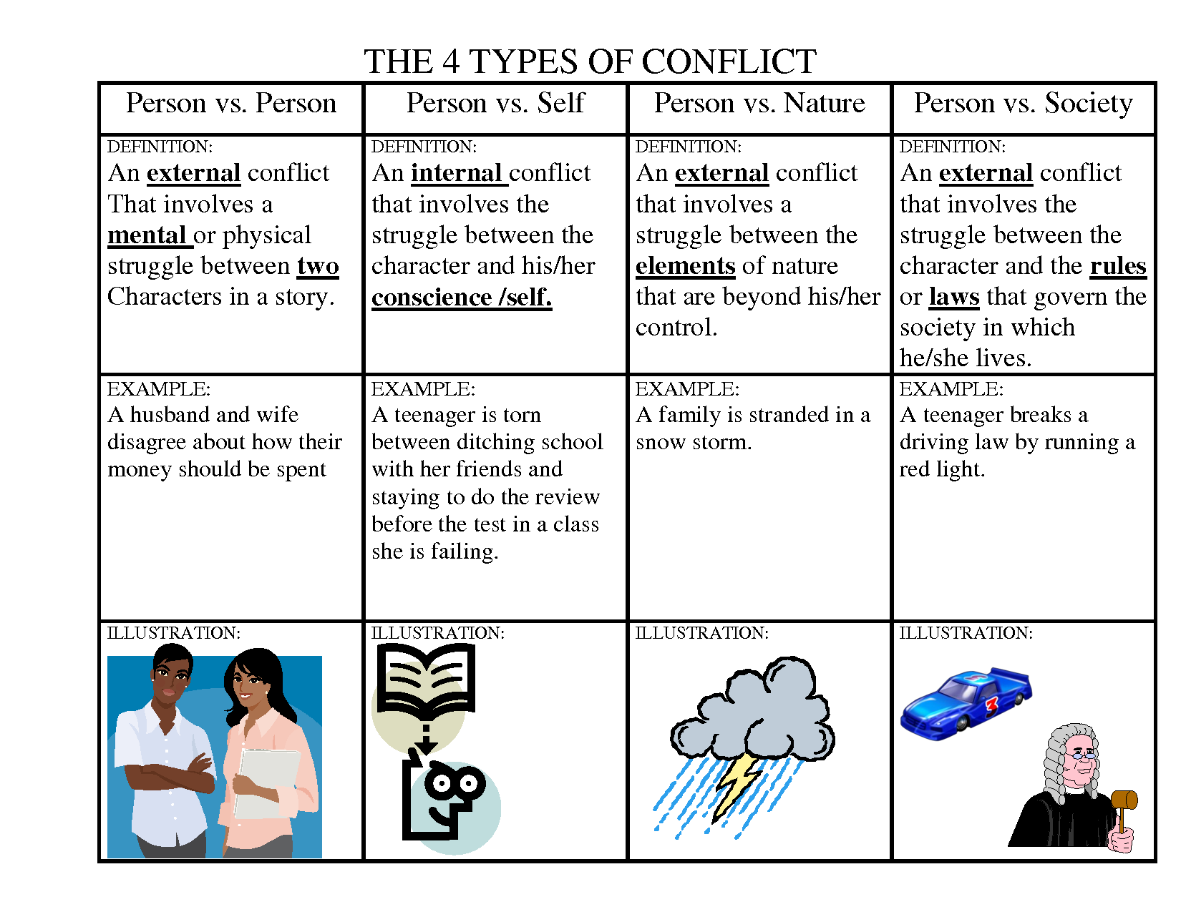

Slide 27
Conflict in The Crossover
Dad vs. Self
Their dad wouldn’t have surgery, so he lost his playing career.
The boys’ dad won’t go to the doctor, so he gets sicker instead of getting better.
JB vs. Josh
JB ditches Josh for a girl. Josh gets jealous.

Slide 28
Context Clues
Information from the surrounding words that gives meaning to an unknown word

Slide 29
Context Clues in The Crossover
Page 39
Calamity is the unknown word.
Context clues are: cut 5 locks, bald patch, mom has a fit, dreadful
Page 142
Churlish is the unknown word.
Context clues are selfish, bad attitude, choke artist, annoyed, grumpy

Slide 30
Euphemism
A more pleasant (or nice) way of saying something that might be inappropriate or uncomfortable

Slide 31
What do these common euphemisms mean?
Stretch the truth
Bath tissue
A few fries short of a happy meal
Lose your lunch/toss your cookies
Spill the beans
Break wind/pass gas

Slide 32
On the next few slides, you will practice identifying euphemisms and their meanings while using appropriate conversation skills.

Slide 33
Partner 1: “My aunt’s horse, Black Beauty, passed away over the weekend.”
Partner 2: “The euphemism is ___________________.”
Partner 1: “The literal meaning of this euphemism is _______________________.”
Both partners discuss why you think we would use this euphemism rather than saying the literal meaning.

Slide 34
Partner 2: “My brother was let go from his McDonald’s job for always being late.”
Partner 1: “The euphemism is ___________________.”
Partner 2: “The literal meaning of this euphemism is _______________________.”
Both partners discuss why you think we would use this euphemism rather than saying the literal meaning.

Slide 35
Partner 1: “My dad’s hair is getting a little thin on top.”
Partner 2: “The euphemism is ___________________.”
Partner 1: “The literal meaning of this euphemism is _______________________.”
Both partners discuss why you think we would use this euphemism rather than saying the literal meaning.

Slide 36
Partner 2: “The bank robber was placed in a correctional facility.”
Partner 1: “The euphemism is ___________________.”
Partner 2: “The literal meaning of this euphemism is _______________________.”
Both partners discuss why you think we would use this euphemism rather than saying the literal meaning.

Slide 37
Partner 1: “Our fifteen-year-old Labrador had to be put to sleep after a fight with a rattlesnake.”
Partner 2: “The euphemism is ___________________.”
Partner 1: “The literal meaning of this euphemism is _______________________.”
Both partners discuss why you think we would use this euphemism rather than saying the literal meaning.

Slide 38
Partner 2: “May I go to the restroom?”
Partner 1: “The euphemism is ___________________.”
Partner 2: “The literal meaning of this euphemism is _______________________.”
Both partners discuss why you think we would use this euphemism rather than saying the literal meaning.

Slide 39
Partner 1: “His sticky fingers got him in trouble with mall security.”
Partner 2: “The euphemism is ___________________.”
Partner 1: “The literal meaning of this euphemism is _______________________.”
Both partners discuss why you think we would use this euphemism rather than saying the literal meaning.

Slide 40
Partner 2: “I’m not short; I’m vertically challenged.”
Partner 1: “The euphemism is ___________________.”
Partner 2: “The literal meaning of this euphemism is _______________________.”
Both partners discuss why you think we would use this euphemism rather than saying the literal meaning.

Slide 41
Euphemism in The Crossover
Page 228
“Dad is gone.” “Crossed over”
Both mean that their dad died.

Slide 42
Flashback
Interrupting current events in the story line to present a past event

Slide 43
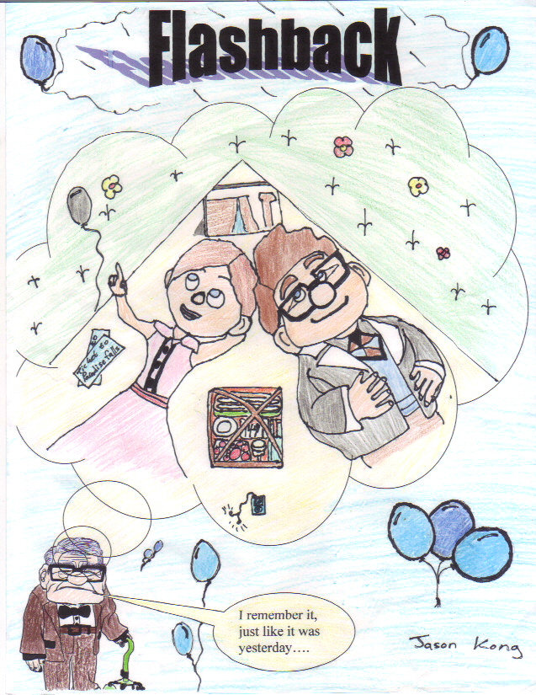

Slide 44
Flashback in The Crossover
Page 64
Their dad tells them a story about the guy at the park who wanted to lower the goal for the boys when they were three years old.

Slide 45
Foreshadowing
The author’s use of clues to hint at coming events in the narrative (story)

Slide 46
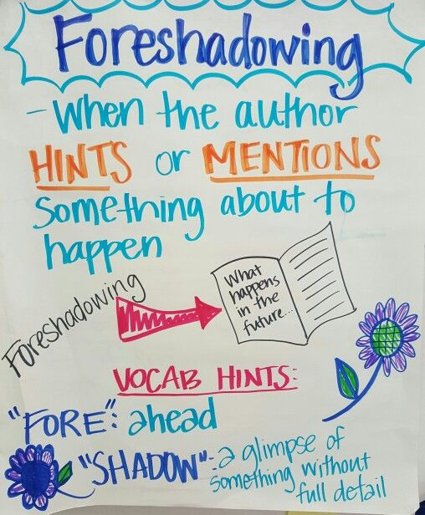
https://www.youtube.com/watch?v=2qi0b_gb4U4

Slide 47
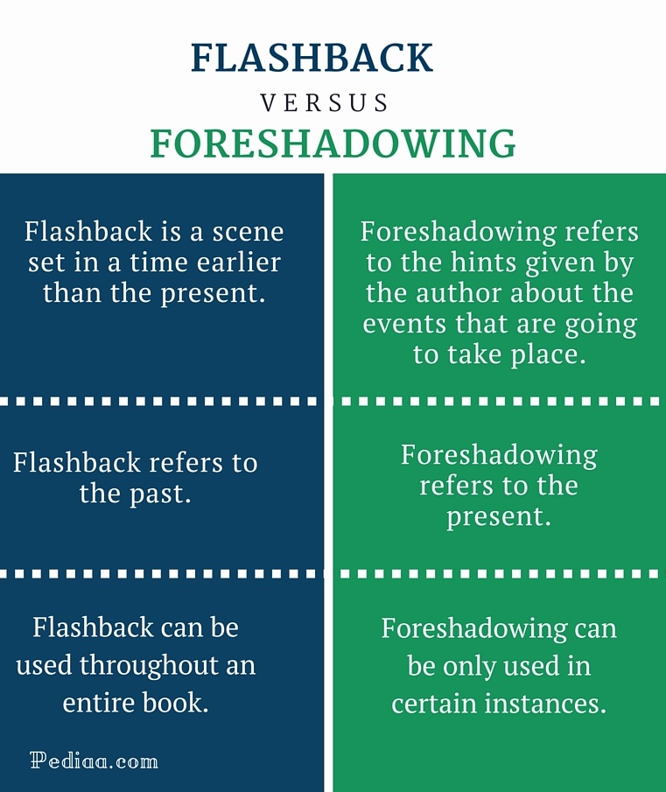

Slide 48
Foreshadowing in The Crossover
Page 32
JB touches Josh’s hair. This hints that something will happen to Josh’s hair.
Page 42. Mom takes the salt from the table when no one is looking.
Page 58 Dad can’t eat food with too much salt.
Hints that something is wrong with the way the dad is eating, that this is an important detail.

Slide 49
Humor
Text meant to entertain in a light manor, often using funny or absurd situations

Slide 50
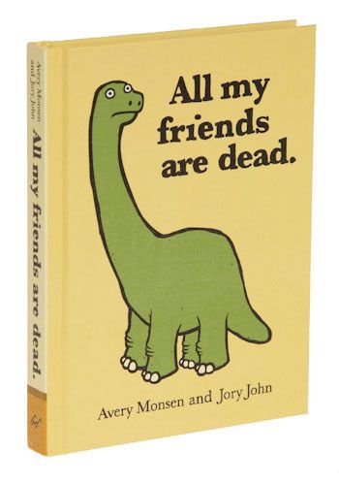
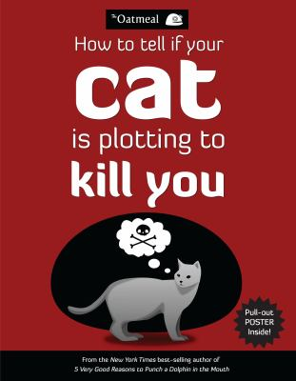
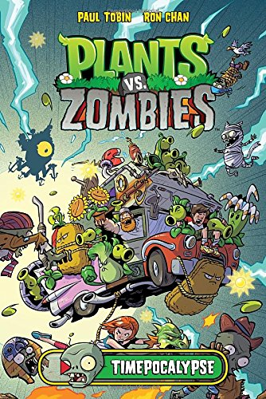
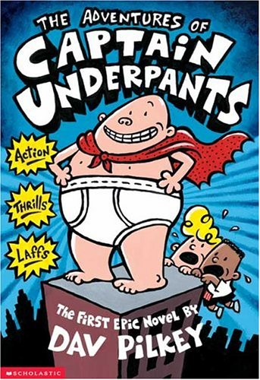

Slide 51
Humor in The Crossover
Page 13
JB hits his brother with his jock strap

